Slide 1
Apache Kafka
Brief Introduction

Slide 2
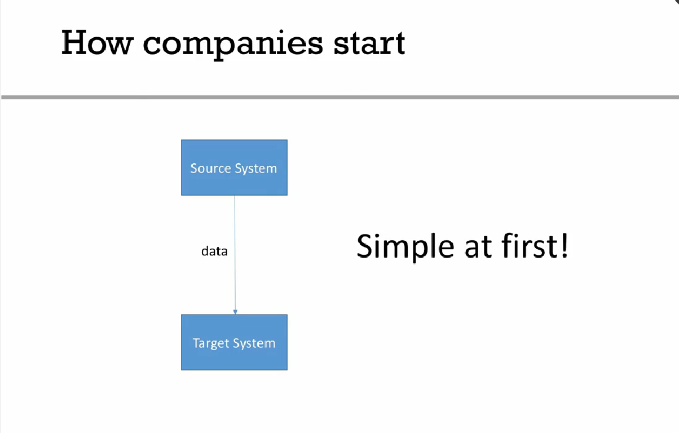
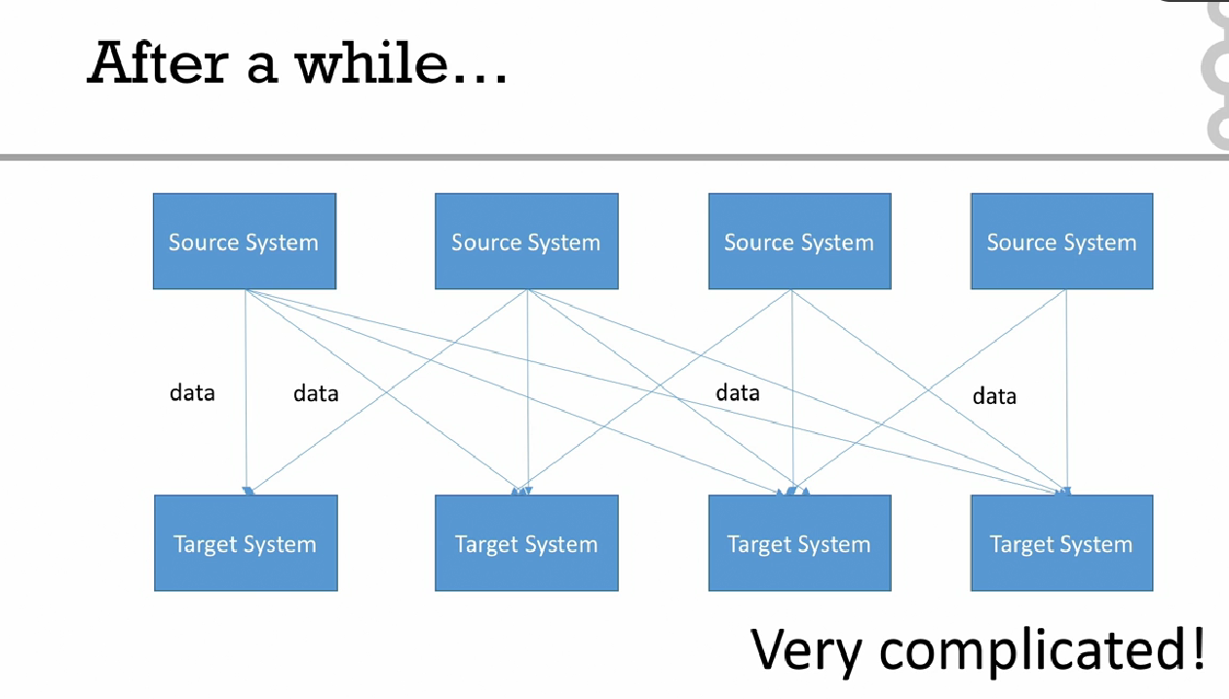
THE NEED
Initial System
Integrated System

Slide 3
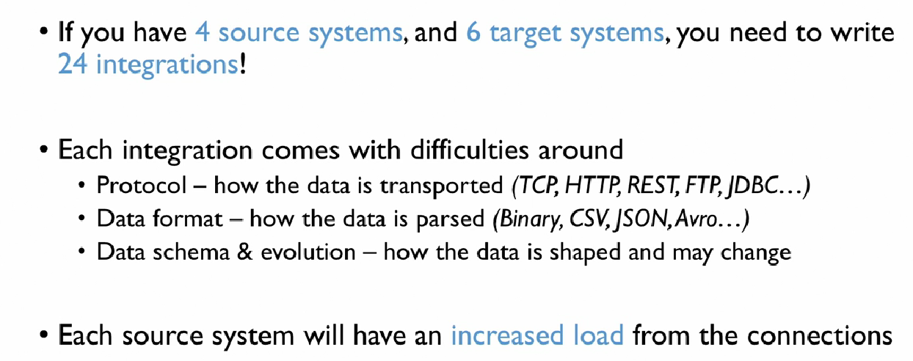
Problems with legacy systems

Slide 4
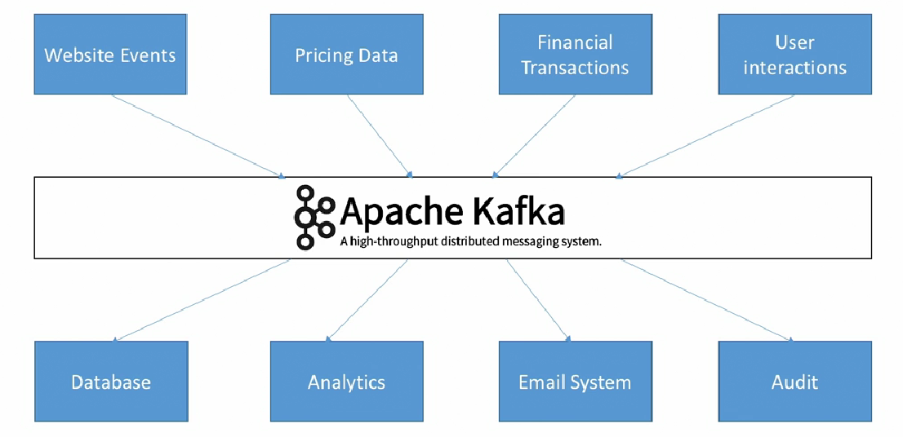
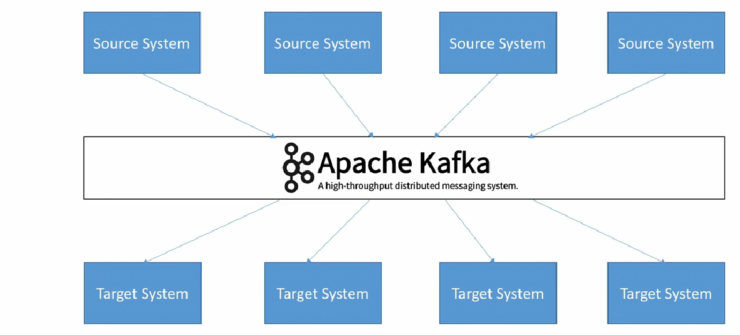
KAFKA to the rescue
Decoupling
Earlier via MOM
SOA
MQ Products
Now Defacto Kafka

Slide 5
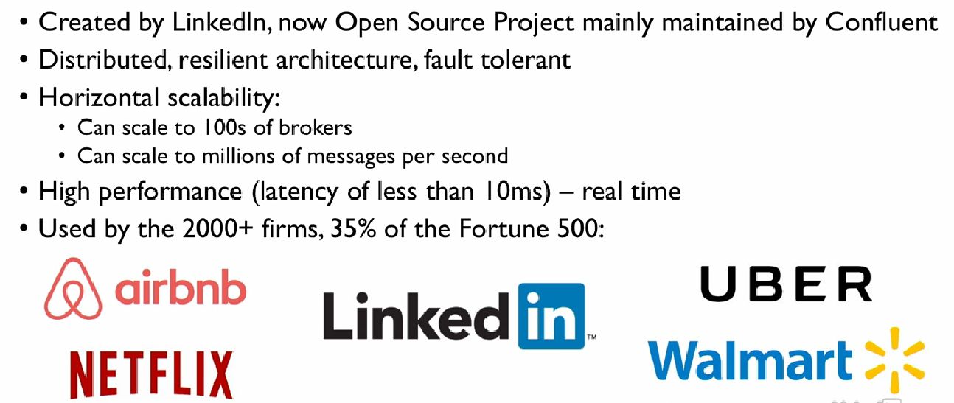
Why Kafka?

Slide 6
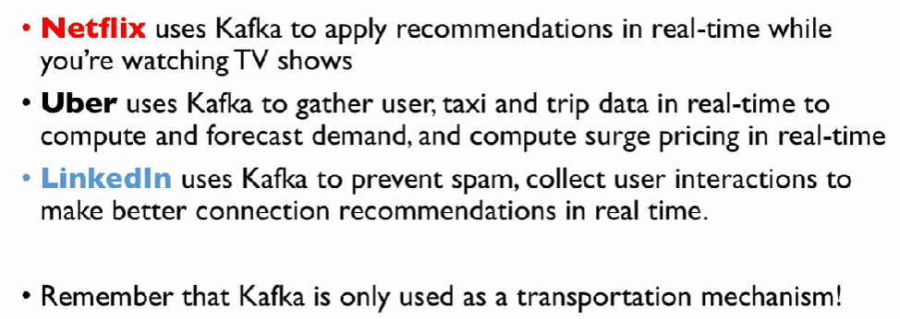
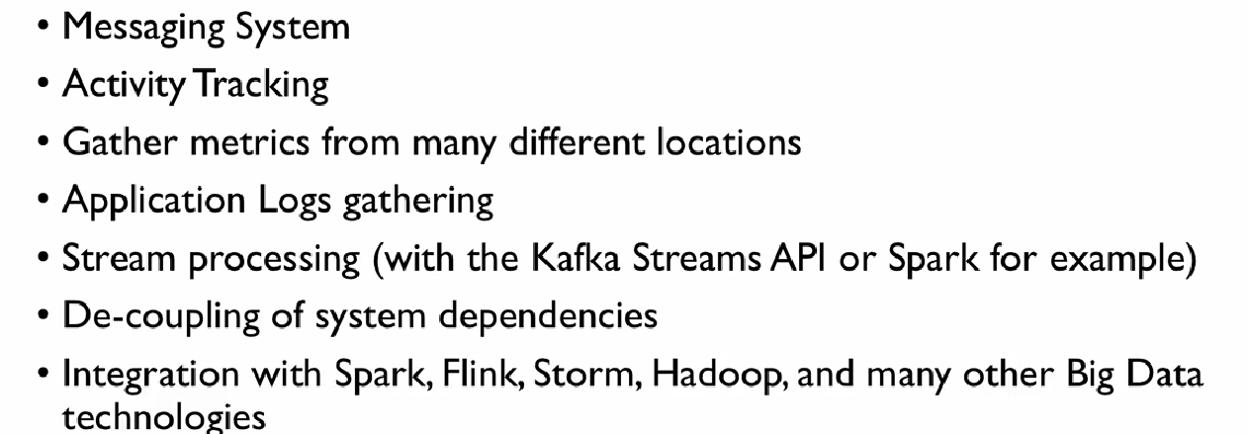
Use Cases

